Slide 1
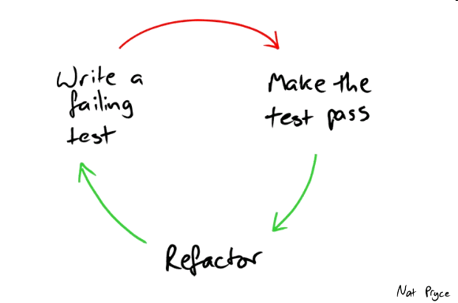
3. semester
Test and Refactoring

Slide 2
Agenda
Test
Definition
Types of tests
Refactoring
Definition
Refactoring examples
Refactoring exercise
Agile testing

Slide 3
Test
Definition
Testing is the systematic process of evaluating a system or its component(s) with the intent to find whether it satisfies the specified requirements or not
i.e. to identify any gaps, errors, or missing requirements in contrary to the actual requirements.

Slide 4
Verification and validation
Verification | Validation
Are you building it right? | Are you building the right thing?
Ensures that the software meets all the functionality | Ensures that the functionalities meet the intended behaviour
Takes place first and includes the checking for documentation, code, etc. | Occurs after verification and mainly involves the checking of the overall product.
Done by developers | Done by testers and end users

Slide 5
Black-box testing
Testing without having any knowledge of the interior workings of the application
Typically, a tester will interact with the system's user interface by providing inputs and examining outputs without knowing how and where the inputs are worked upon
Advantages | Disadvantages
Well suited and efficient for large code segments | Limited coverage, only a number of test scenarios is performed
Code access is not required | Inefficient testing, due to the fact that the tester only has limited knowledge about an application
Clearly separates user's perspective from the developer's perspective | Blind coverage, since the tester cannot target specific code segments or error-prone areas
 | The test cases are difficult to design

Slide 6
White-box testing
Detailed investigation of internal logic and structure of the code
A tester needs to know the internal workings of the code
Also known as glass testing or open-box testing
Advantages | Disadvantages
Easier to find out which type of data can help in testing the application effectively | Due to the fact that a skilled tester is needed the costs are increased
Helps optimizing the code | Difficult to maintain white-box testing, as it requires specialized tools like code analysers and debugging tools
Due to knowledge about the code, maximum coverage is attained during test scenario writing | Impossible to look into every corner to find hidden errors that may create problems, as many paths will go untested.

Slide 7
Grey-box testing
Testing with a limited knowledge of the internal workings of an application
Access to design documents and the database
Advantages | Disadvantages
Offers combined benefits of black-box and white-box testing | The ability to go over the code and test coverage is limited due to lack of source code
Don't rely on the source code; instead they rely on interface definition and functional specifications | The tests can be redundant if the software designer has already run a test case
Excellent test scenarios for communication protocols and data type handling based on the limited information | Testing every possible input stream is unrealistic because it would take an unreasonable amount of time
The test is done from the point of view of the user and not the designer

Slide 8
A Comparison of Testing Methods
Black-box | Grey-box | White-box
The internal workings need not be known | Limited knowledge of the internal workings | Full knowledge of the internal workings
Also known as closed-box testing, data-driven testing, or functional testing | Also known as translucent testing | Also known as clear-box testing, structural testing, or code-based testing
Performed by end-users and also by testers and developers | Performed by end-users and also by testers and developers | Normally done by testers and developers
Based on external expectations - Internal behaviour is unknown | Based on high-level database diagrams and data flow diagrams | Internal workings are fully known, the test data can be designed accordingly
It is exhaustive and the least time-consuming | Partly time-consuming and exhaustive | The most exhaustive and time-consuming
only be done by trial-and-error | Data domains and internal boundaries can be tested, if known | Data domains and internal boundaries can be better tested

Slide 9
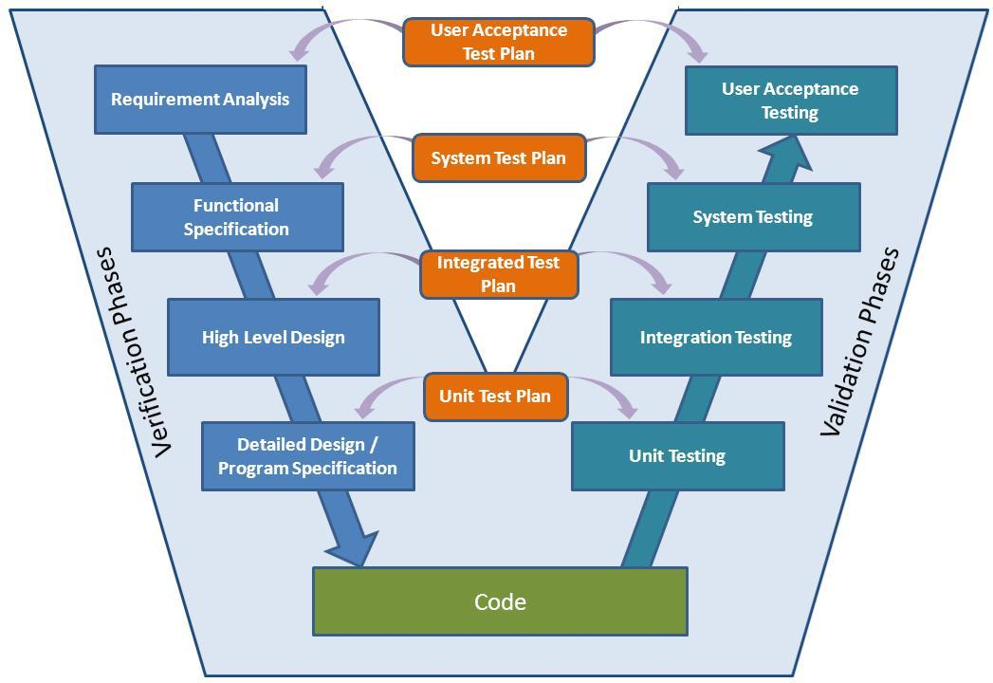
When to test

Slide 10
Acceptance testing
The most important type of testing, as it is conducted by the customer/ end users
Gauge whether the application meets the intended specifications and satisfies the client’s requirement
Acceptance tests are not only intended to point out simple spelling mistakes, cosmetic errors, or interface gaps
Acceptance tests will also to point out any bugs in the application that will result in system crashes or major errors in the application

Slide 11
System testing
Tests the system as a whole
Once all the components are integrated, the application as a whole is tested rigorously to see that it meets the specified Quality Standards
Important because:
The application is tested thoroughly to verify that it meets the functional and technical specifications
The application is tested in an environment that is very close to the production environment
System testing enables us to test, verify, and validate both the business requirements as well as the application architecture

Slide 12
Integration testing
Testing of combined parts of an application to determine if they function correctly
Bottom-up integration
Begins with unit testing, followed by tests of progressively higher-level combinations of units called modules or builds
Top-down integration
The highest-level modules are tested first and progressively, lower-level modules are tested thereafter
In a comprehensive software development environment, bottom-up testing is usually done first, followed by top-down testing

Slide 13
Functional testing
A type of black-box testing that is based on the specifications of the software that is to be tested
The application is tested by providing input and then the results are examined
Functional testing of a software is conducted on a complete, integrated system to evaluate the system's compliance with its specified requirements
Steps:
Determine the functionality that the intended application is meant to perform
Creation of test data based on the specifications of the application
Specify expected output based on the test data and the specifications of the application
write test scenarios and the execute test cases
compare actual and expected results based on the executed test cases

Slide 14
Unit testing
The goal of unit testing is to isolate each part of the program and show that individual parts are correct in terms of requirements and functionality
Unit testing is performed by the developers
Limitations:
Testing cannot catch each and every bug in an application
It is impossible to evaluate every execution path in every software application

Slide 15
Regression testing
Whenever a change in a software application is made, it is quite possible that other areas within the application have been affected by this change
Regression testing is performed to verify that a fixed bug hasn't resulted in another functionality or business rule violation
The intent of regression testing is to ensure that a change, such as a bug fix should not result in another fault being uncovered in the application
Important because:
Minimize the gaps in testing when an application with changes made has to be tested
Testing the new changes to verify that the changes made did not affect any other area of the application
Test coverage is increased without compromising timelines
Increase speed to market the product

Slide 16
Test V-model

Slide 17
Non-functional testing
Involves testing a software from the requirements which are non-functional in nature but important
Performance Testing is mostly used to identify any bottlenecks or performance issues
Load Testing is a process of testing the behaviour of a software by applying maximum load in terms of software accessing and manipulating large input data
Stress Testing includes testing the behaviour of a software under abnormal conditions
i.e. it may include taking away some resources or applying a load beyond the actual load limit
Usability testing is used to identify any error(s) and improvements in the software by observing the users through their usage and operation ( black-box technique)
UI testing involves testing the Graphical User Interface in terms of color, alignment, size, and other properties

Slide 18
Test documentation
Test Plan outlines the strategy that will be used to test an application
Test Scenario is a one line statement that notifies what area in the application will be tested
Test scenarios are used to ensure that all flows are tested from end to end
Test scenarios include several rest cases
Test cases involve a set of steps, conditions, and inputs that can be used while performing testing tasks
The main intent of this activity is to ensure whether a software passes or fails in terms of its functionality and other aspects
Test case ID
Pre-conditions
Steps
Expected outcome.
Actual outcome
Post-conditions

Slide 19
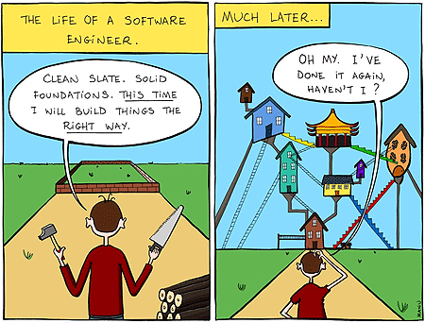
Refactoring

Slide 20
Why refactor?
Reality
Extremely hard to get the design right the first time
Hard to understand the business domain fully
Hard to understand the requirements – even if the users do
Hard to predict how the system will evolve over the next years
The original design is often inadequate
The system get fragile over time – and thus harder to maintain
Refactoring helps by
Manipulate she system in a safe environment
Recreate a situation where evolution is possible
Understand existing code
XP advocates simple first, then refactor

Slide 21
Why refactor?
Maintaining Quality
Professionalism
Before
After
Unreadable code
Duplicated code
Complex code
Hard to modify
Easier to understand
Cheaper to modify
Simple code
Robust code

Slide 22

Readability
Which part is the easier to read?
if (date.before(summer_start) || (summer_end))
charge = quantity * winterRate + winterServiceCharge;
else
charge = quantity * summerRate;
if (isSummer(date))
charge = summerCharge(quantity);
else
charge = winterCharge(qunatity);

Slide 23
When to refactor?
When:
After new features has been implemented
Errors are corrected
During code review
Only while refactoring
Do not add new features while refactoring
When not to refactor:
Sometimes the better approach is to ditch it all – and start over
Sometimes you can isolate the mess behind an interface

Slide 24

Rename method
If the name of a method does not reveal its purpose
Change the name of the method

Slide 25
A technical aside
The underlying complexity of rename is surprising
Managing rename in large systems.
Rename a method name vs. rename a concept
invName -> inventoryName
Frame -> Morph

Slide 26
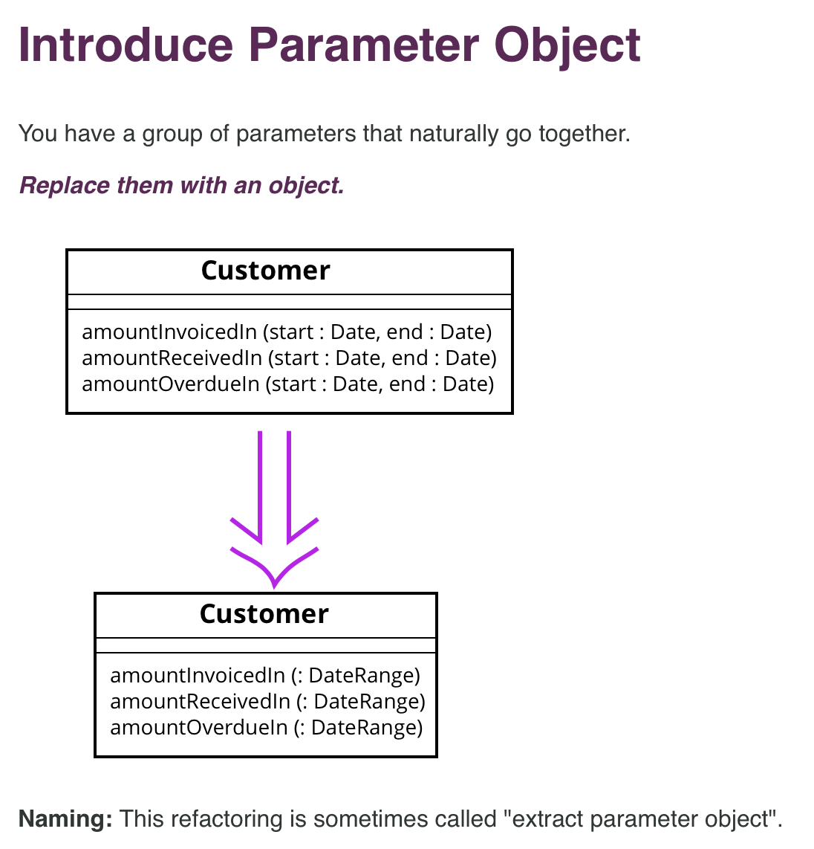

Slide 27
The builder pattern
(see http://www.informit.com/articles/article.aspx?p=1216151&seqNum=2)
class FooBuilder {
T1 a;
T2 b;
…;
FooBuilder setA(T1 a){
this.a = a;
return this;
}
...
Foo create(){...}
}
Foo = new FooBuilder()
.setB(12)
.setD(“Lars”)
.create();
class Foo {
…
Foo(T1 a, T2, b, T3 c, T4 d){...}
Foo(T1 a, T2 b){...}
Foo(T2 b, T4 d){...}
...
}
Foo = new Foo( 12, “Lars”);

Slide 28
More about refactoring
Fowler video: https://www.youtube.com/watch?v=vqEg37e4Mkw
Catalogue of refactoring:
http://refactoring.com/catalog/
Refactoring a first example:
http://www.cs.unc.edu/~stotts/723/refactor/chap1.html
Refactoring to patterns:
http://industriallogic.com/xp/refactoring/catalog.html

Slide 29
Exercise
Vedlagt (på fronter) er en udgave af den klassiske bankkonto, med mulighed for at indsætte og hæve.
Det er uden for jeres kontrol blevet besluttet at den skal laves om, således at:
Der skal laves subklasser der implementerer de forskellige konto typer
Objekter skal laves ved hjælp af en builder.
Account skal dækkes bag et interface.
I skal løse denne opgave som par-programmering, skift hvert kvarter (ja, det vil man ikke gøre i praksis, men dette er en øvelse).
De tre punkter overfor er ikke ment som rækkefølge. Det er ikke ligegyldigt hvilken rækkefølge man gør dette i. I skal vælge en god rækkefølge.
I skal i videst mulig omfang benytte jer af de refaktoreringsværktøj der er i NetBeans.

Slide 30
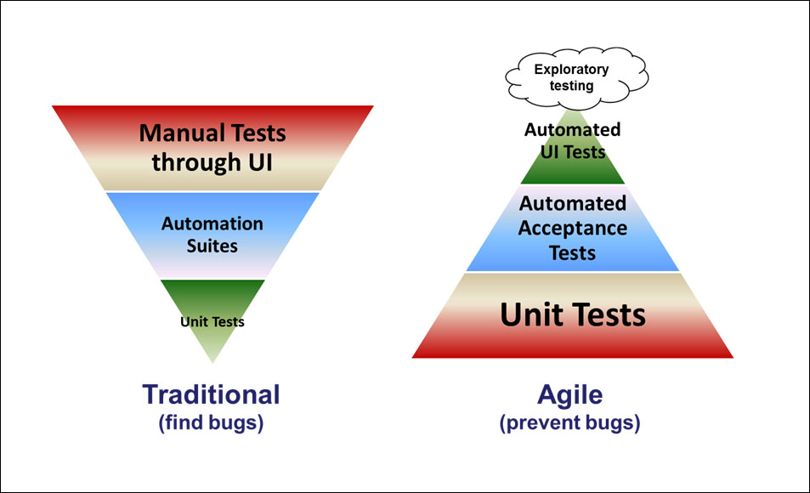
Agile testing

Slide 31
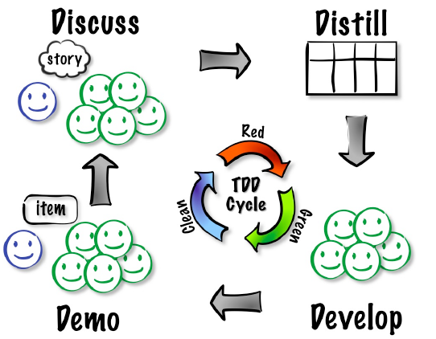
Acceptance Test Driven Development (ATDD) Cycle

Slide 32
ATDD paper at a glance
TDD is a programming practice, not a testing technique.
Practicing Test Driven Development is about expectations guiding the implementation
Acceptance Test Driven Development (ATDD) also emphasize tests before code
In ATDD, the team creates acceptance-level tests for a feature before beginning work on it.
These tests are captured when the team is working with the business stakeholder to understand a story on the backlog.

